Slide 1


Python For Consultants
Reem Tahir
Cognitive Consultant/Data Scientist

Slide 2

Your Instructor
Reem Tahir
Cognitive Consultant/ Data Scientist GBS, CbD
Reem Tahir attended Southern Methodist University, studying Statistical Sciences. She completed the General Assembly Data Science Immersive Bootcamp. Reem is currently a data scientist at IBM.
Email: reem.td@gmail.com
Github: https://github.com/ReemTahir

Slide 3
Why Should Consultants Know Python?
Python is one of the most common programming languages
It is fairly easy to learn because it is one of the closest to human language
Allows you to communicate better with technical team members
Helps you understand software implications of business decisions
Puts you ahead of the curve compared to other consultants who don’t understand the product or problems as intimately

Slide 4
Course Overview
Lesson 1: Set up & Overview
Lesson 2: Python Basics
Lesson 3: More Python
Lesson 4: Loading & Cleaning Data
Lesson 5: Data Visualization Basics
Lesson 6: Storytelling 101
Capstone Project

Slide 5
Lesson 1: Set Up

Slide 6
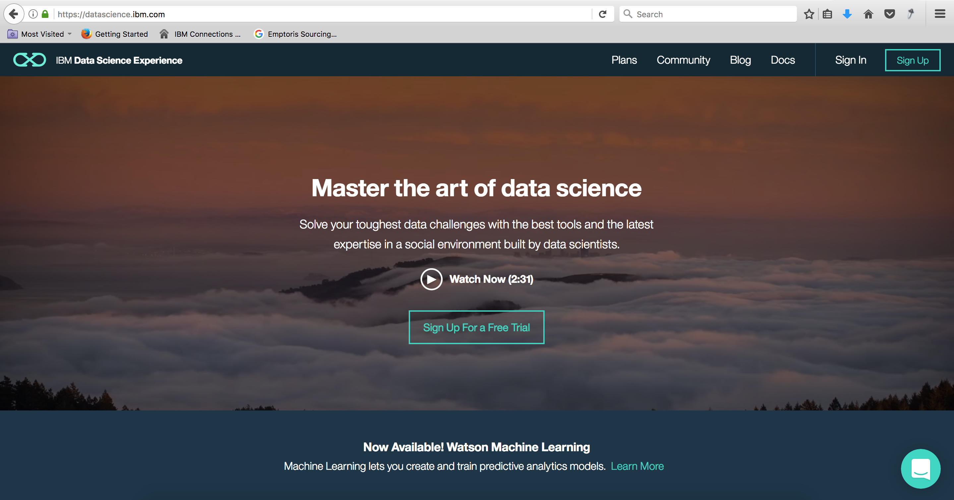
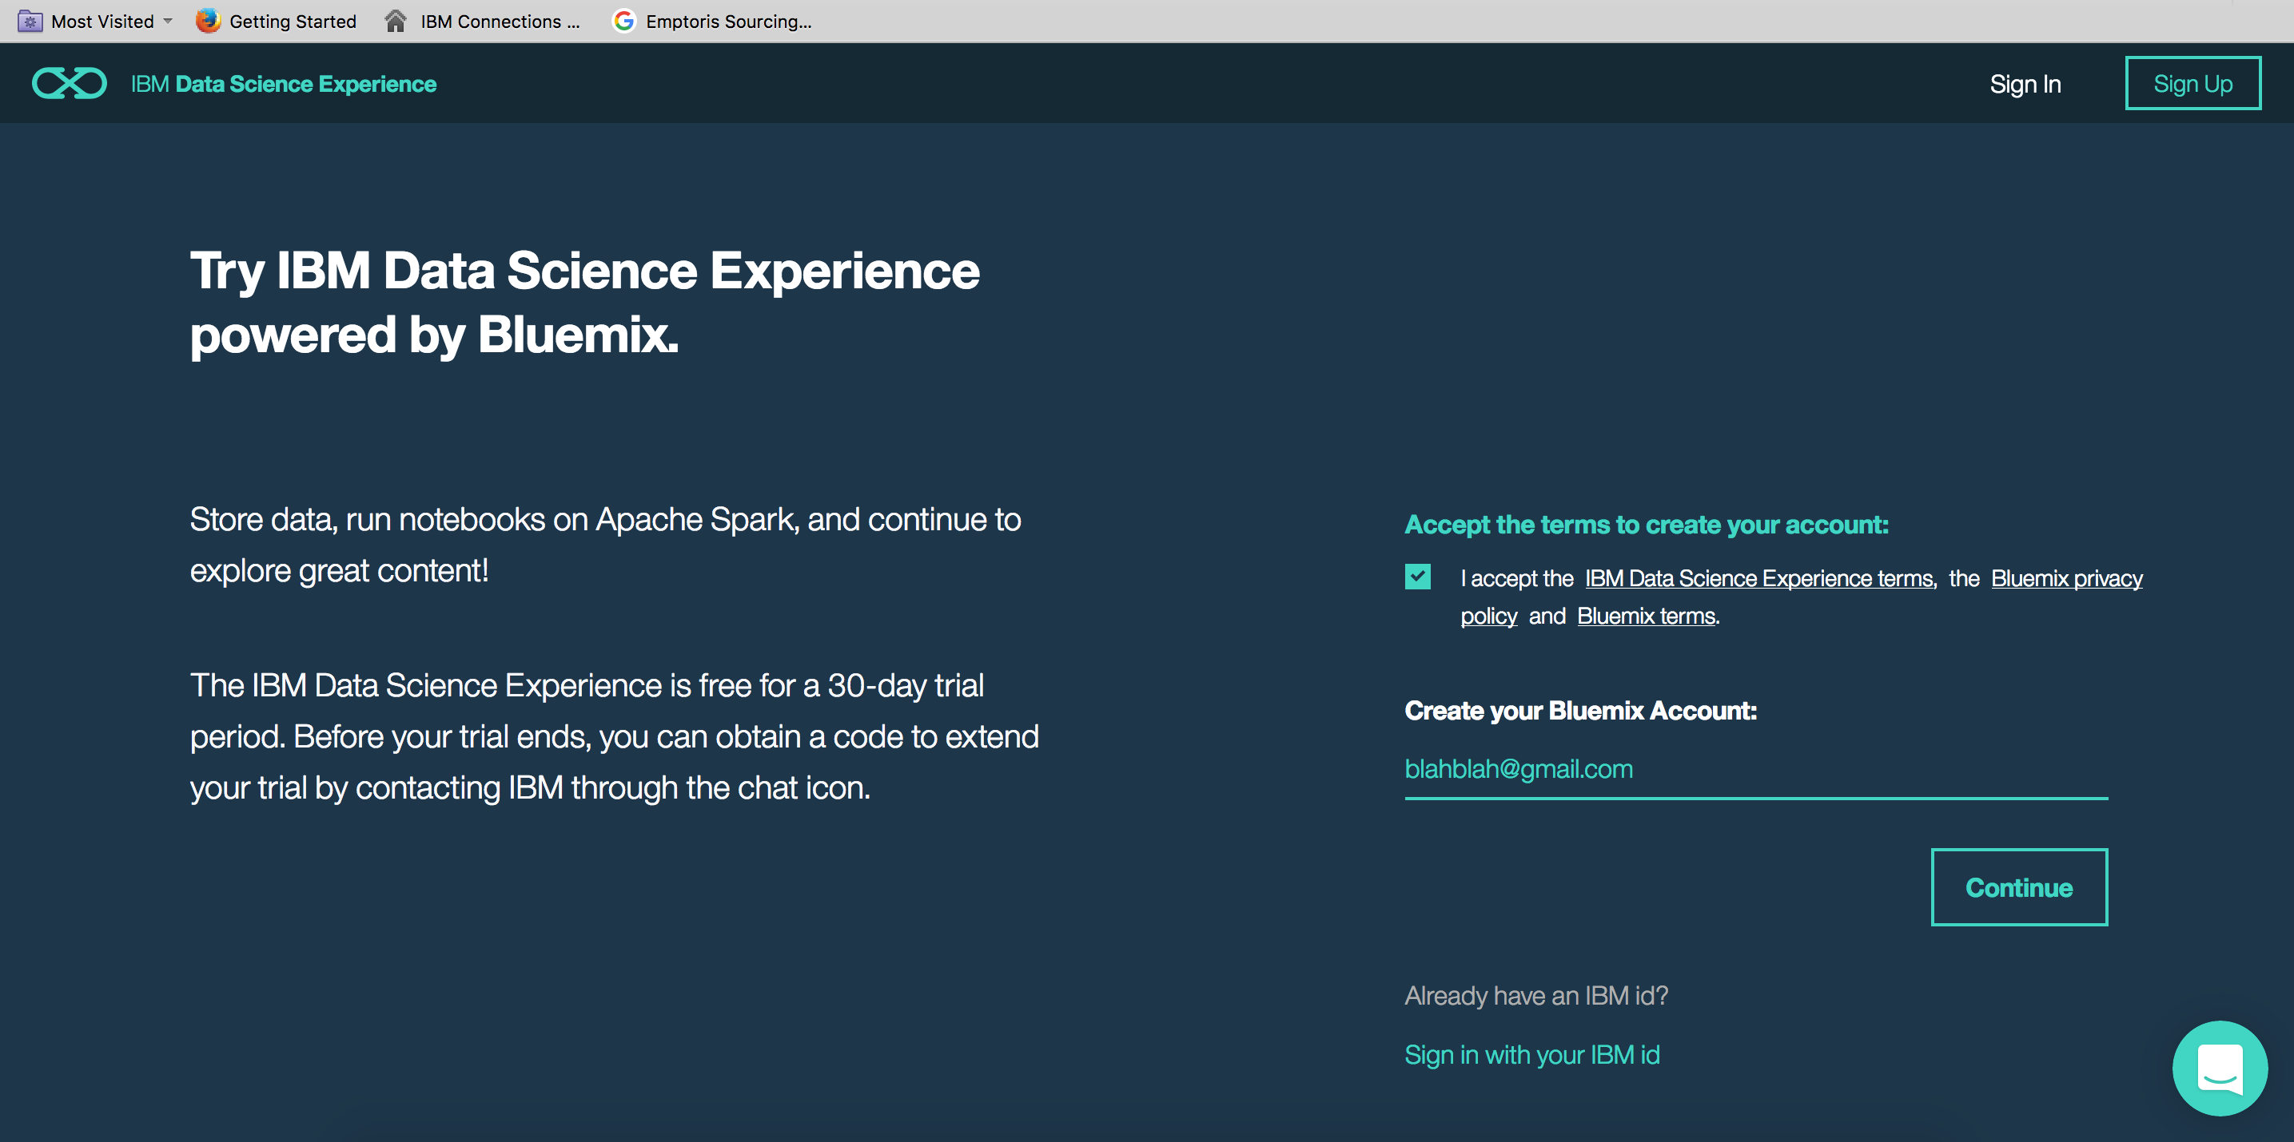
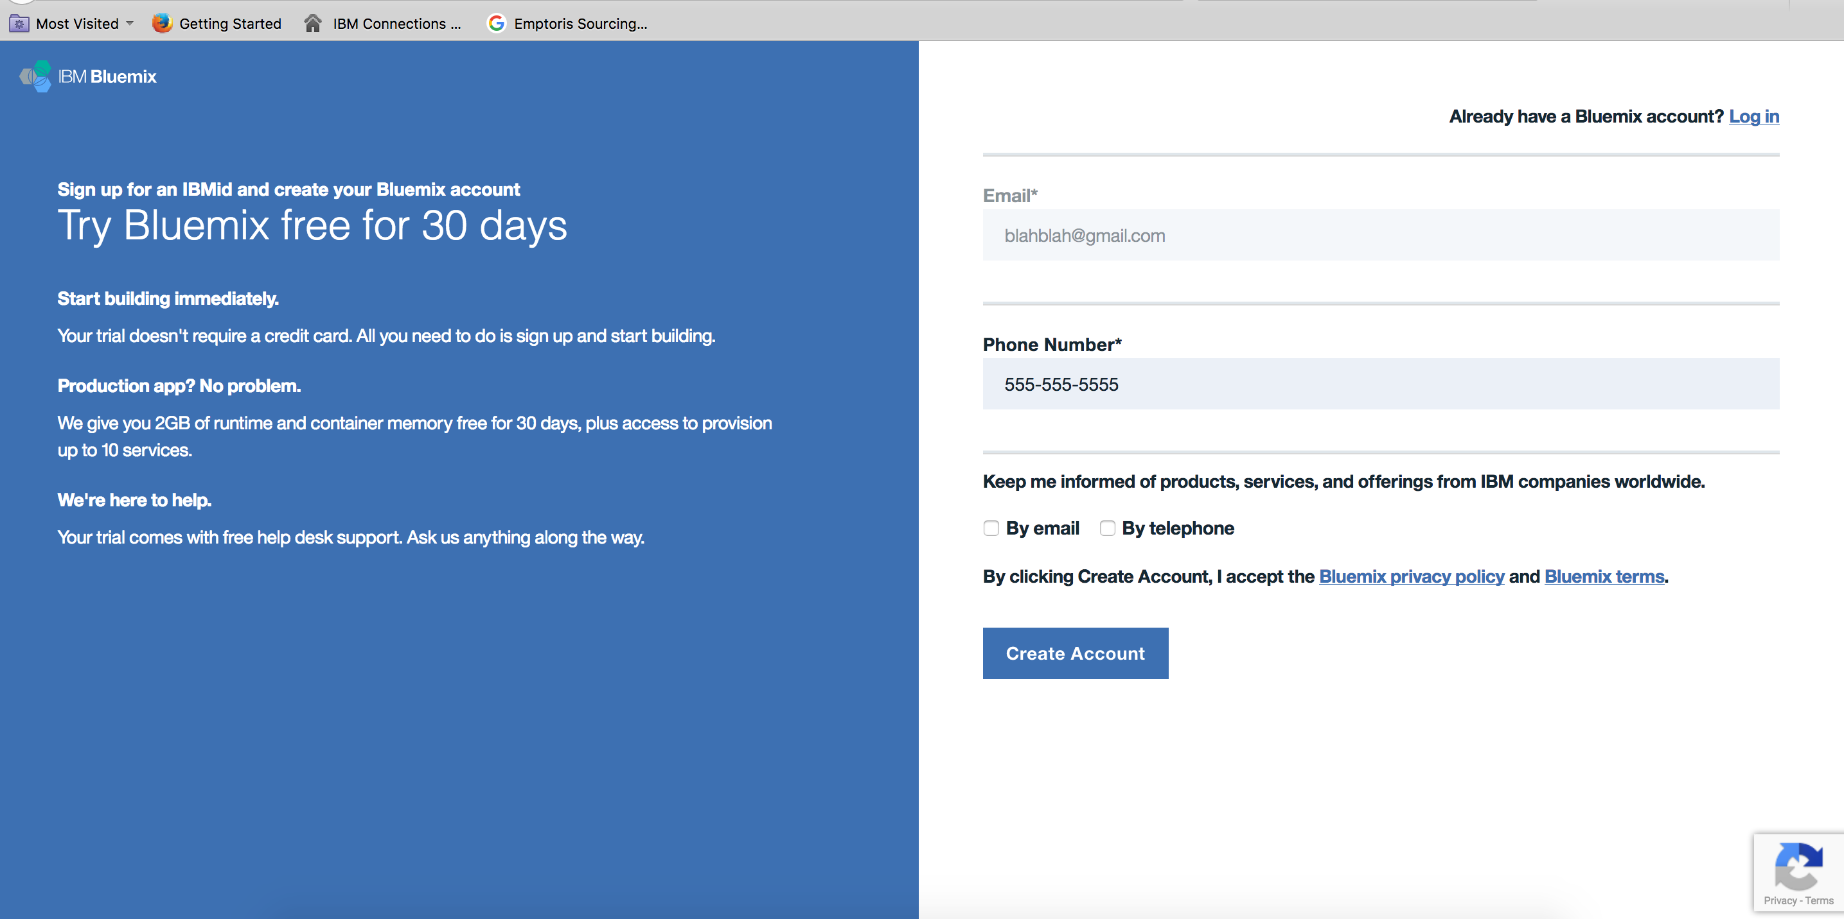
Create a DSX Account
Step 1:
Go to : https://datascience.ibm.com/
Step 2:
Click Sign up on top right corner
Step 3:
Fill in your email

Slide 7
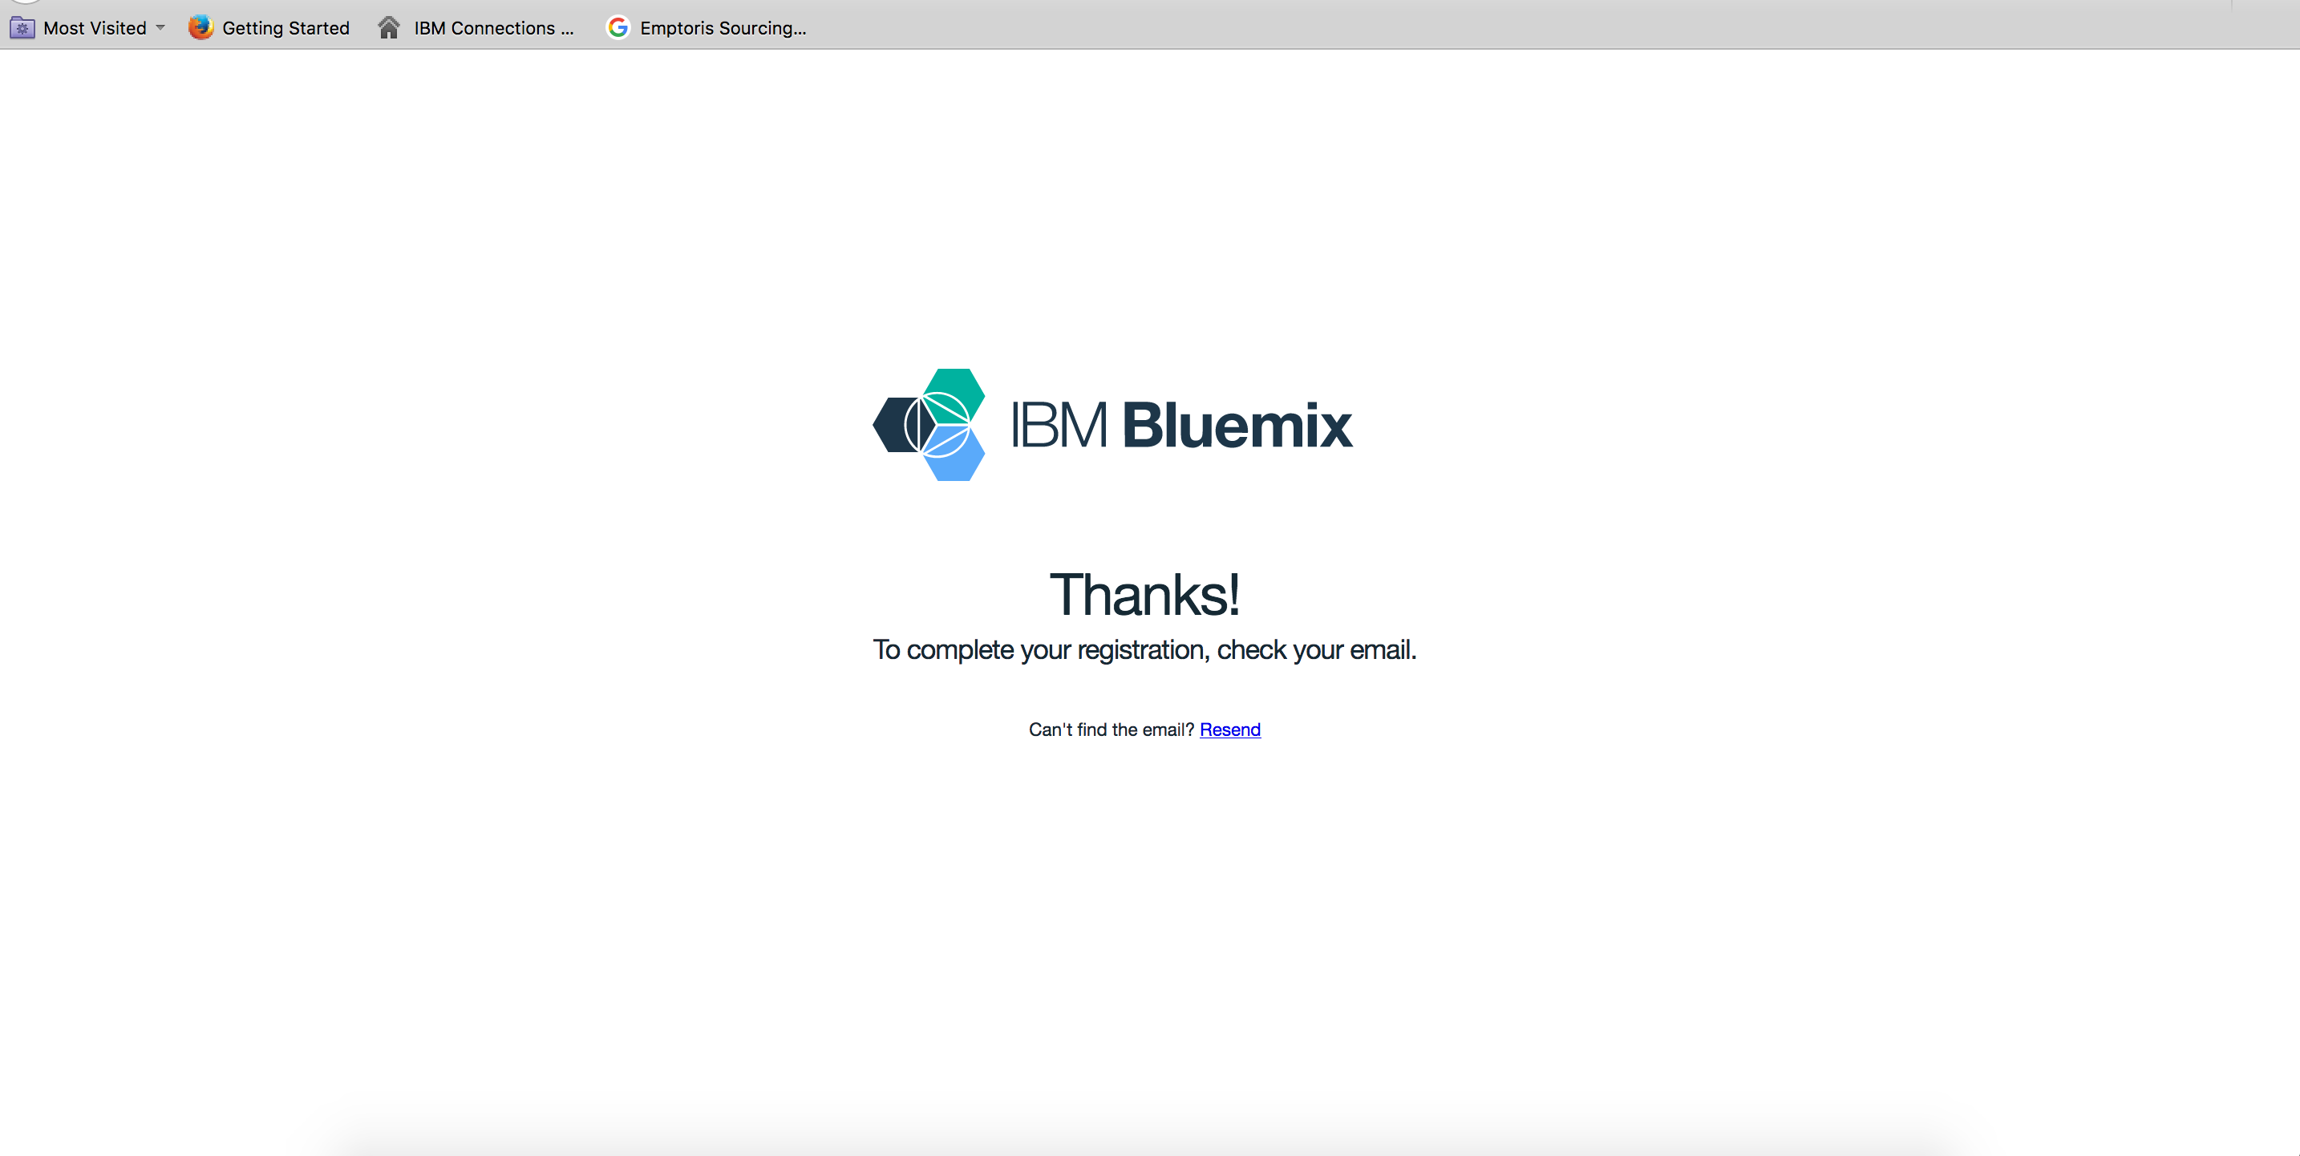
Final Steps: Open your email and click the confirmation Link

Slide 8
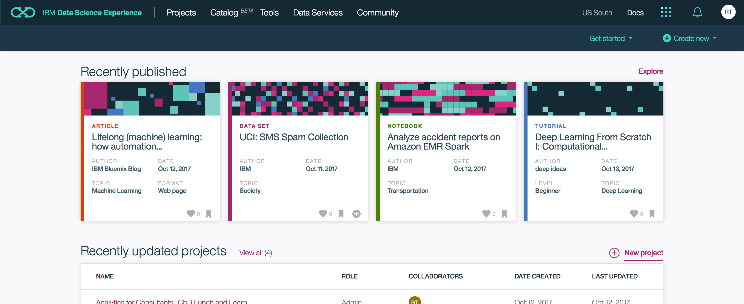
Navigating the Dashboard
Your Projects Connects to AWS or other Cloud Object Storage
Open new Rstudio or Notebook
Helps with loading data
Articles, Data Sets, Tutorials

Slide 9
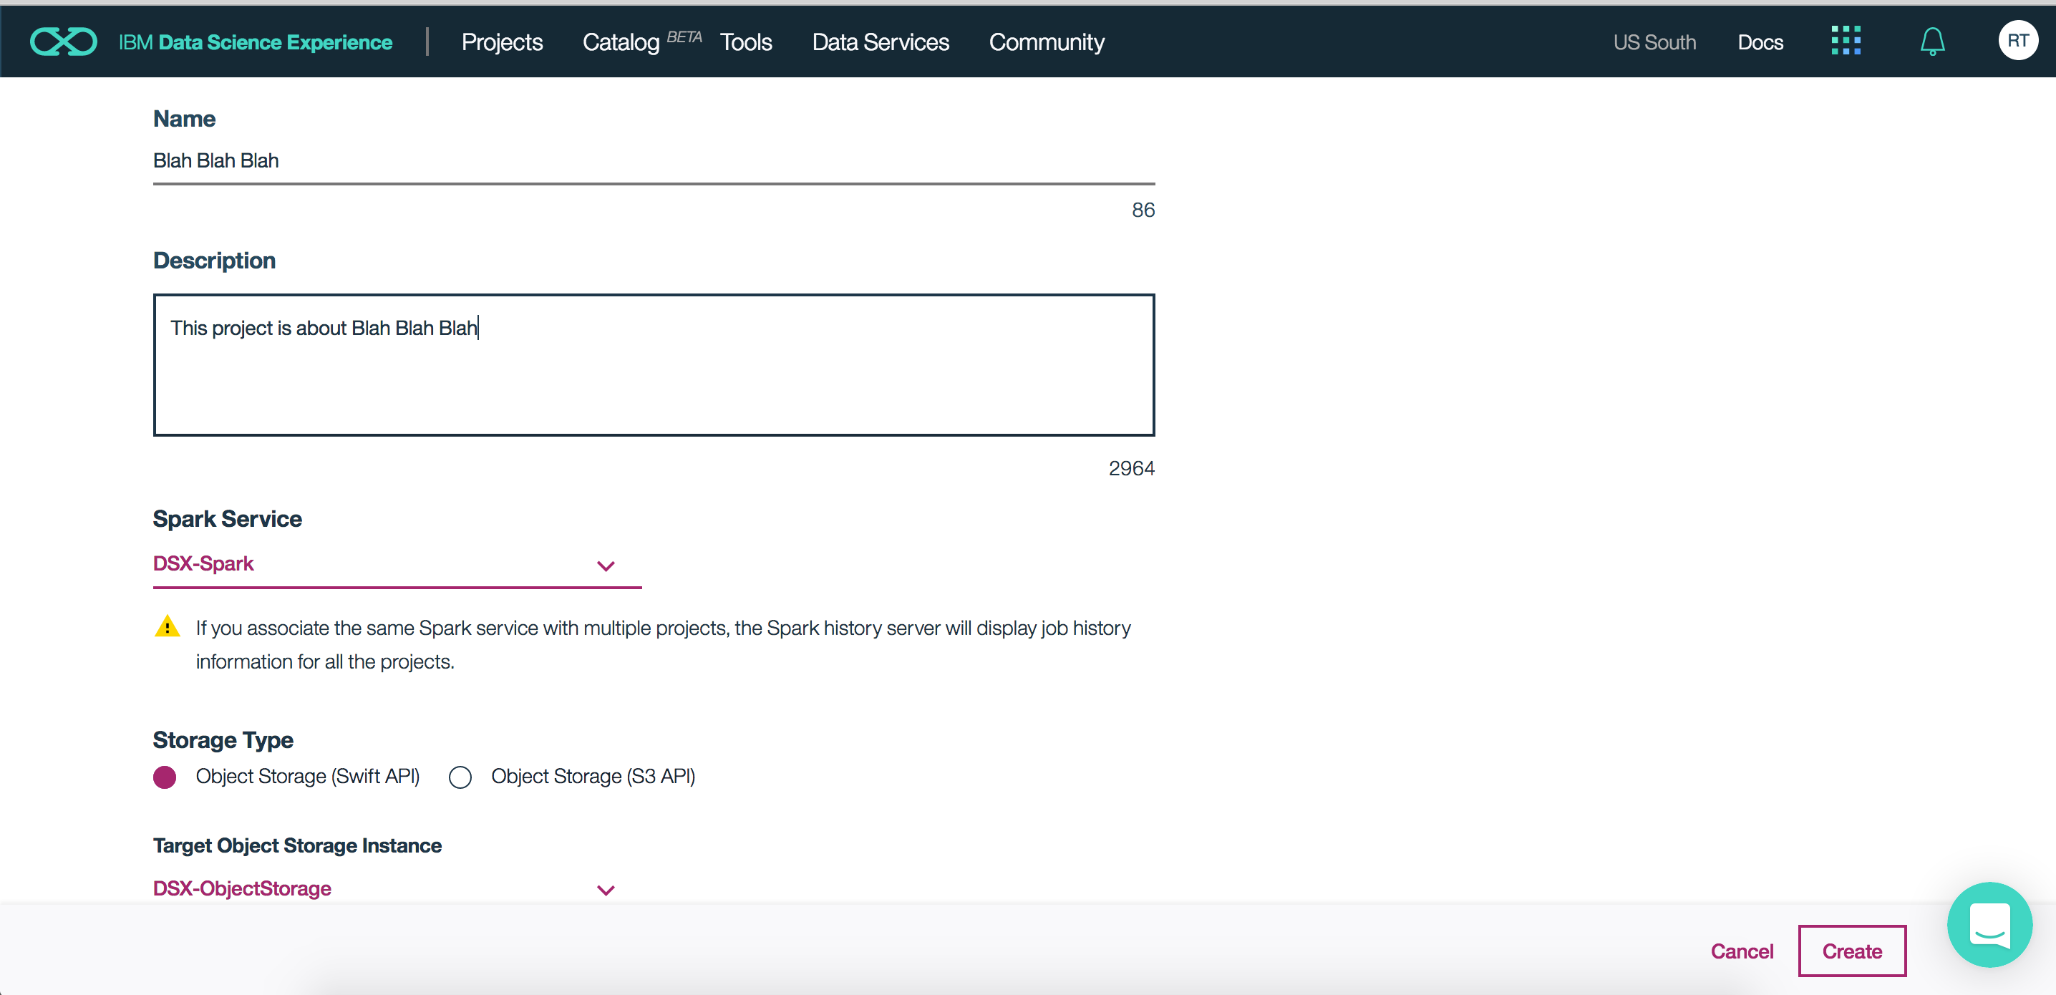
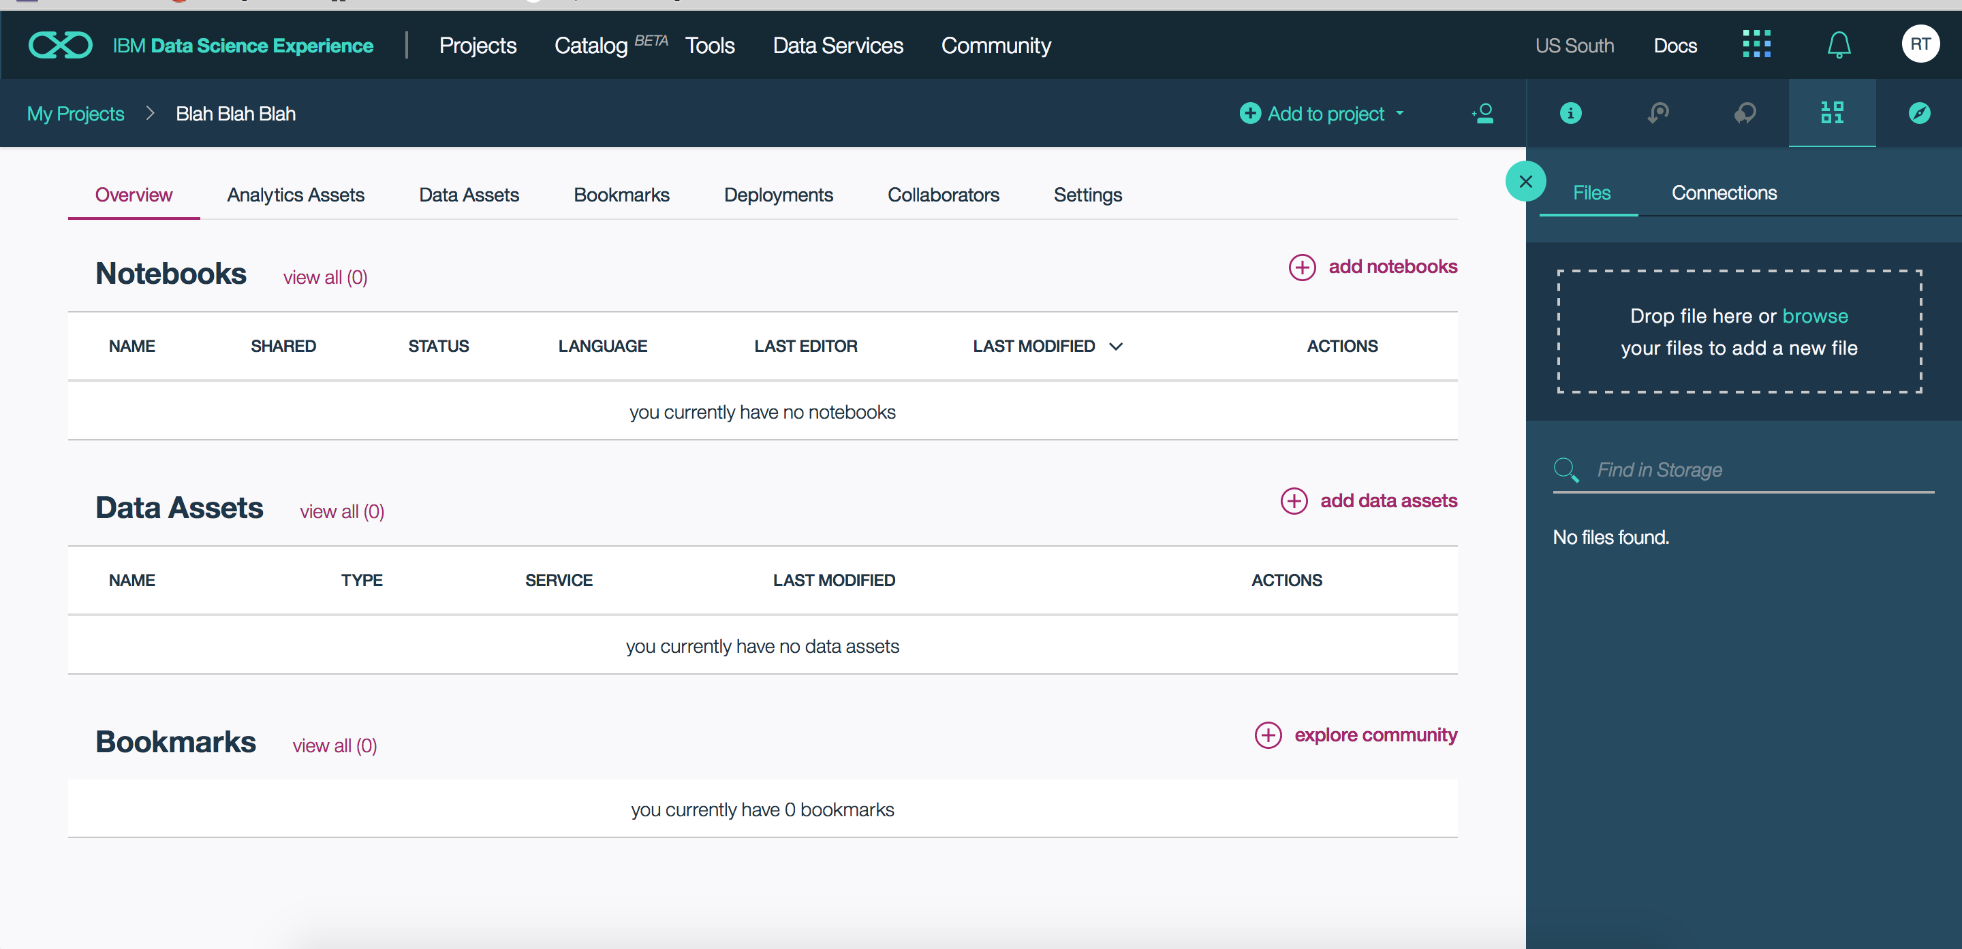
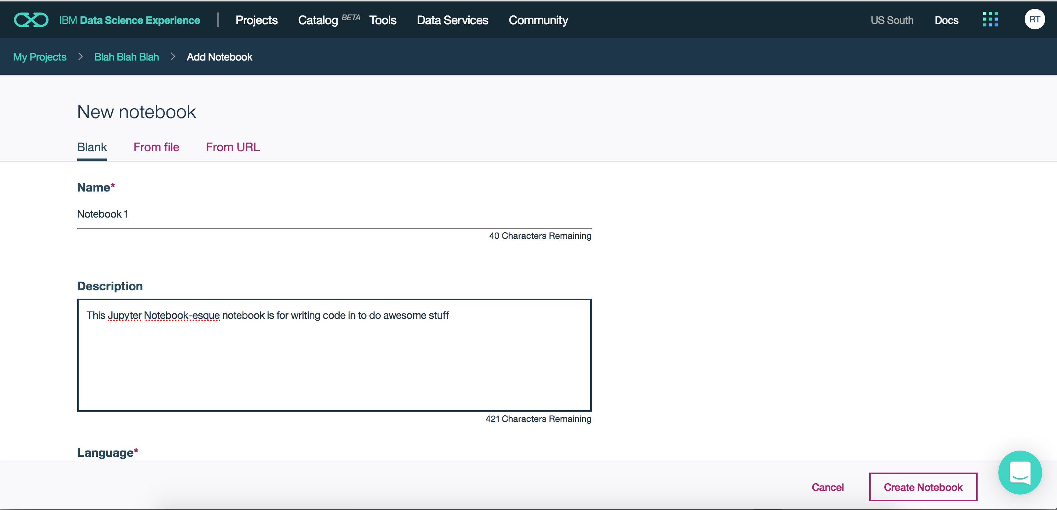
Create New Project!
Step 1:
Name Project and Click “Create”
You don’t need to fiddle with the other options unless you want to change your storage type to AWS, which costs $$$
Step 2:
To Add a Data set click “add Data Assets”
Now click “add notebooks”
Step 3:
Name your notebook and add a description to remind you what it’s for
Click “Create”

Slide 10
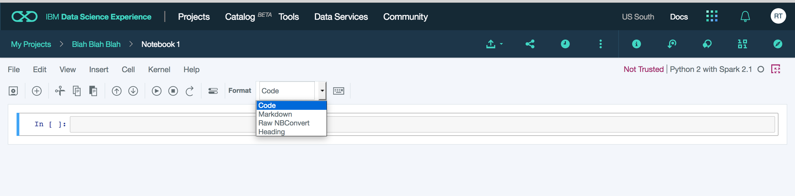
Understanding the Notebook
Cells are the textboxes that you will be coding/writing in
Kernel - a “computational engine” that executes the code contained in a Notebook document, in this case it is a Python Kernel. *Note: If you change the Kernel the code in the whole notebook may ”break” (not work) if it’s in the wrong language
Format Determines the type of cell
Code- Runs Python Code
Markdown- Runs HTML
Raw NBConvert- Can convert your notebook to a different file type (HTML, LaTeX, PDF, reStructuredText, etc.)
Heading- This feature doesn’t work and will prompt you to use Markdown

Slide 11
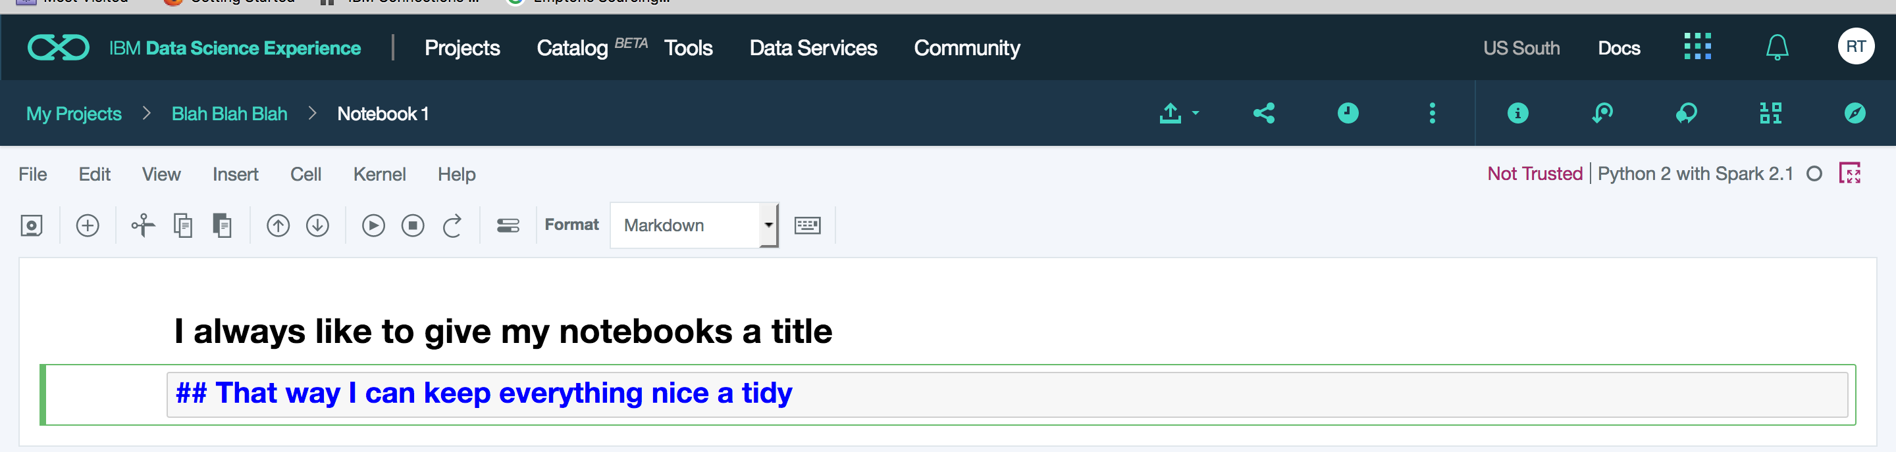
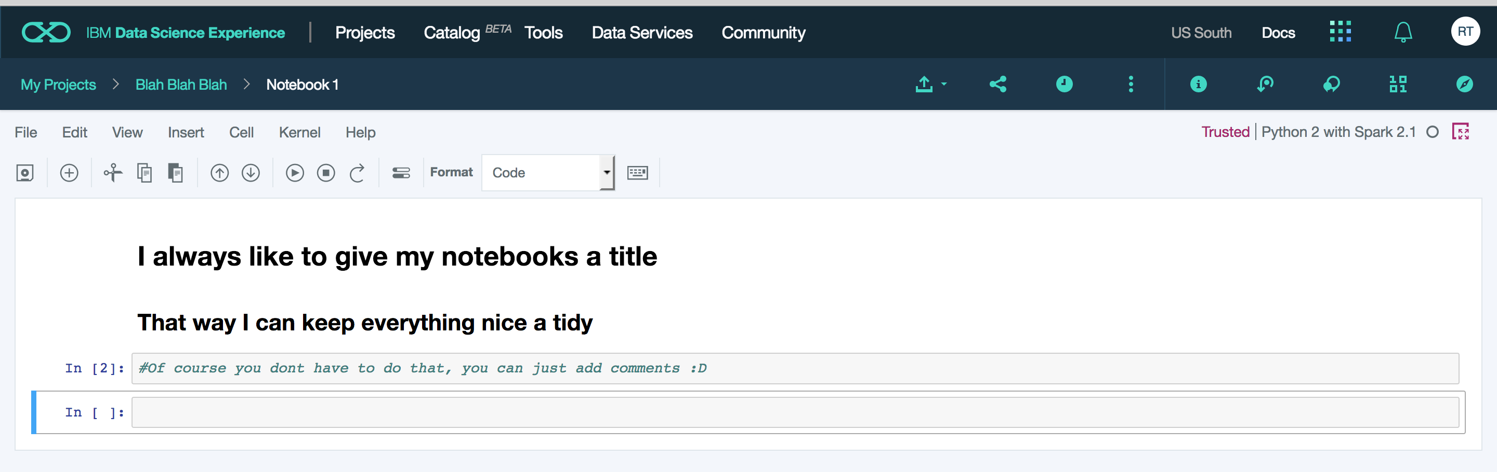
HTML Basics: Hyper-Text Mark-Up Language
<p> You should write text in here</p>
<a href = “website url”> type name of website here</a>
# Heading 1 size
## Heading 2 size
### Heading 3 size
#### Heading 4 size
<p></p> Paragraph size
For more resources on HTML5, CSS, or Javascript visit:
https://www.w3schools.com/

